Slide 2
Create an enterprise Copilot extension for VSCode through Semantic Kernel
Kinfey Lo Microsoft Senior Cloud Advocate

Slide 3



All in Copilot
Windows
Office
GitHub

Slide 4


.NET Developer need to
Azure.AI.OpenAI
Sematic Kernel

Slide 5
Copilot Stack
Apps
Plugin extensibility
Copilots
AI orchestration
Orchestration
Foundation models
AI infrastructure

Slide 6
Semantic Kernel is a lightweight open-source orchestration SDK that lets you easily mix-and-match AI prompts with conventional programming languages like C# and Python.
Semantic Kernel
AI orchestration
Open Source & Trustworthy
Reliable & Performant
Latest AI
Innovations
MS’ Powerful Enterprise Data and Software Ecosystem

Slide 7

Semantic Kernel makes it easier for AI App Devs to get going.
Qdrant Vector DB
1,400 Power Platform Connectors
Docs & Support
State
Memories
Side Effects
Plugins & Connectors
Enterprise Ready
Sequential planner
Copilot Chat
Actions
Planner
AI UX
Samples
Open AI, Azure Open AI, Hugging Face
User
Models
Auto integration
AI App
Devs
Foundation Models
VS Code
Dev Cycle
Telemetry & Tooling

Slide 8
Meet the lightweight Kernel of Semantic Kernel
“
I’ve been designed to orchestrate complicated LLM AI prompts combined with native code, use multiple AI models, and … I have a special skill to PLAN.”
STEPS
👋
PLANNER
1
2
3
…
ernel
ASK
K
“
I take a user’s ask and generate a step-by-step plan that draws upon available skills.”
Planner generates steps that use available Skills
SKILLS

Slide 9
SK Example
ernel
ASK
K
It all starts with a user’s AI ask …
Steps ready from planner
1
2
3
…
VS Code
Create a PR where the description is a summary of my changes
Gather Skills
Gather Context
Gather Connectors
Git Hub
SKILLS
… resulting in new productivity
GET
RUNNING STEPS PIPELINE
Result is ready
1
2
3
…
Execute Steps
1. Summarize changes
2. Create PR

Slide 10
Demo

Slide 11
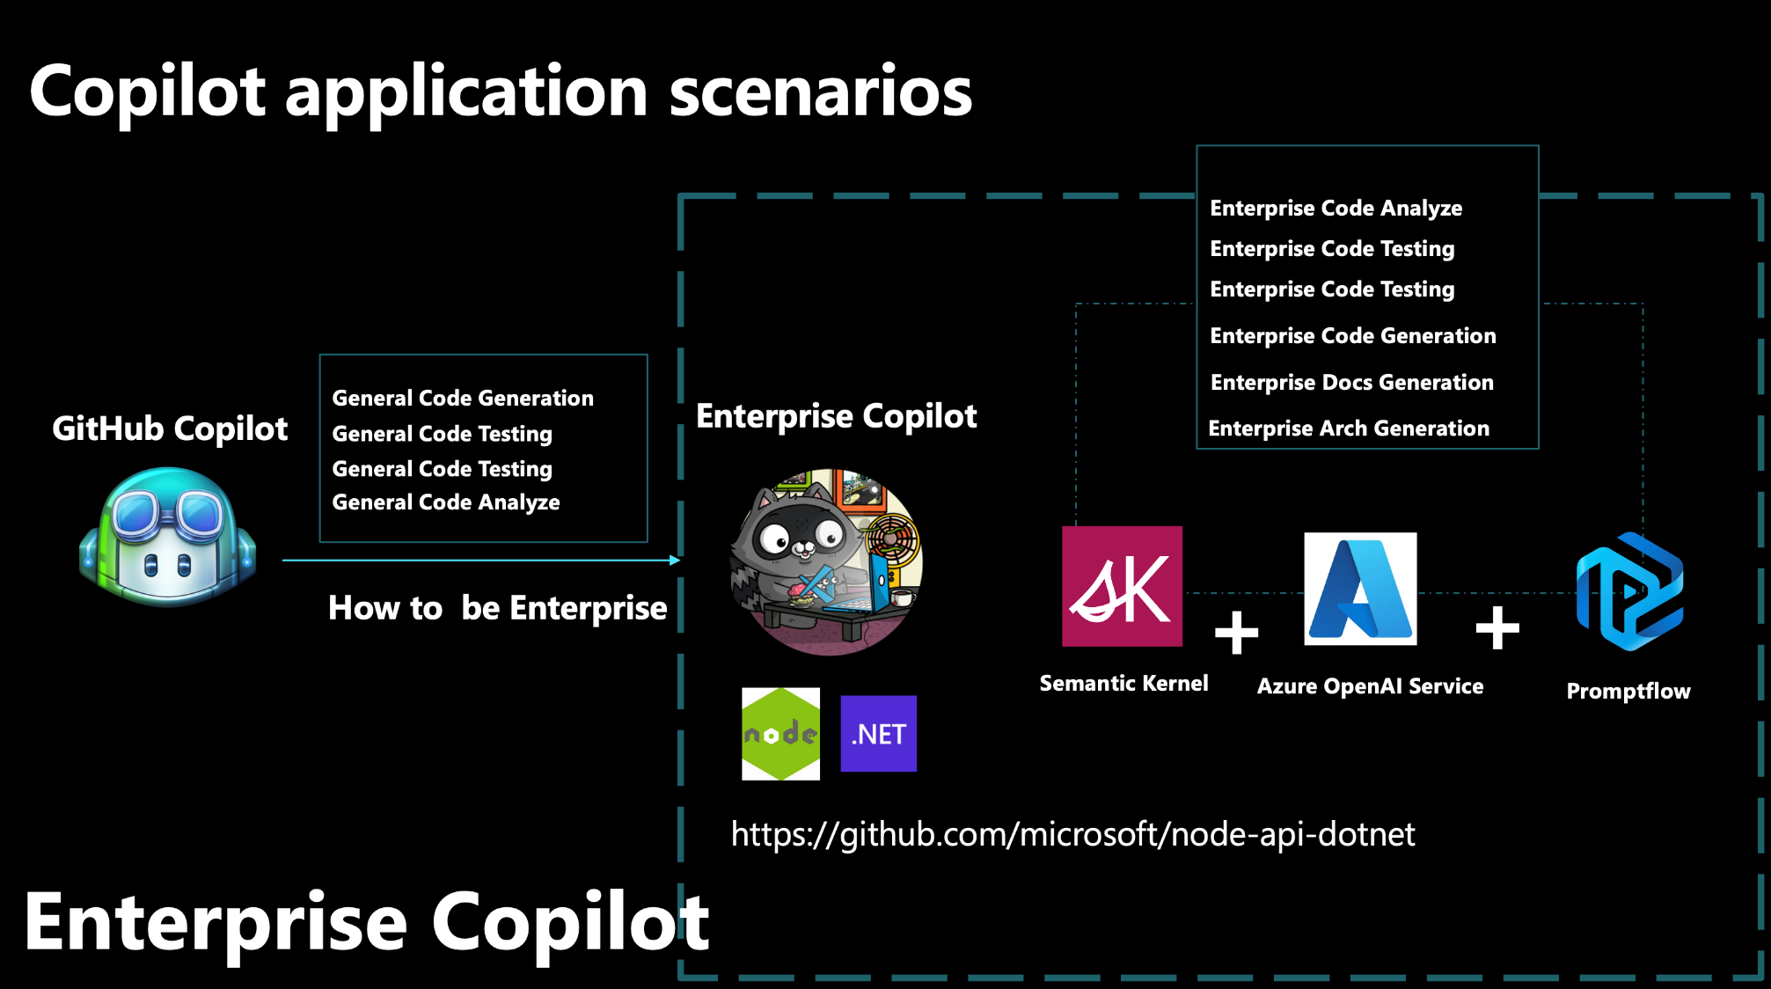

Slide 12

After being hijacked by GitHub Copilot
Enterprise Problem
Enterprise coding style
Enterprise Docs
Developer ❤️ GH Copilot
Enterprise KB
Enpterprise Demo

Slide 13


Enterprise multi-model scenarios will be the future
confidential data
Internal
temporary data
business data
External
common data

Slide 14
Demo

Slide 15


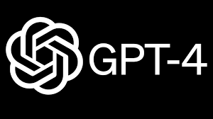
LLMs generative code

Slide 16
How to make stable output based on Prompt

Slide 17
Prompt
Private data access
​Prompt Engineering
​Performance and Evaluation​
Version control and reproducibility​
AI Security
Prompts engineering processes need to be streamlined
Rapid engineering is iterative and challenging, involving multiple steps
data preparation
Making Prompt
Execute using LLM APi
Refine the generated content
the challenges of iteration
Production
Design, evaluate, refine, optimize, produce

Slide 18
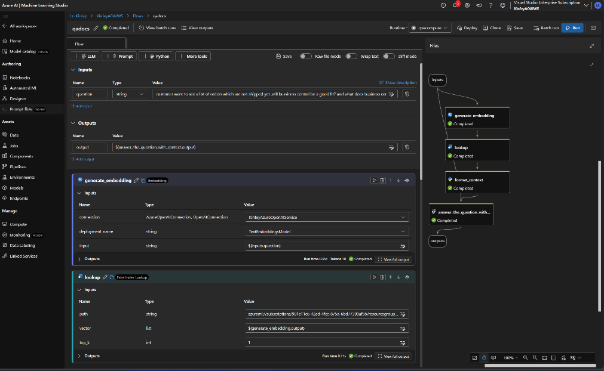
Iterative process for rapid design
Azure Machine Learning Prompt Flow
Azure Machine Learning Prompt Flow is a development tool designed to simplify the entire development cycle of AI applications powered by large language models (LLM), providing a comprehensive solution to simplify prototyping, experimentation, iteration and deployment process.
platform
LLM-supported workflow optimized for adapting and iterating
Promptflow
Enhance development workflow
Develop processes that connect to various language models, external data sources, tools, and custom code
Test and evaluate
Parallel test processes using large data sets
Evaluate the AI ​​quality of your workflow using metrics such as performance, fundamentality, and accuracy
Prompt engineering adjustments
Easily adjust prompt projects and versions
Compare and deploy
Compare different results
One-click deployment to managed endpoints for fast integration

Slide 19
Concept
Connections
A variety of pre-built connections are available for PromptFlow, including Azure Open AI, Open AI, and Azure Content Safety.
Runtimes
The runtime provides pre-built Docker images that include our built-in tools, ensuring all necessary tools are ready to execute.
Flows
Processes in Prompt Flow are available as executable workflows that simplify the development of LLM-based AI applications. It provides a comprehensive framework for managing data flow and processing within applications. In the process, nodes take center stage and represent specific tools with unique functionality. These nodes handle data processing, task execution, and algorithm operations through input and output. By connecting nodes, you can create a seamless chain of operations that guides the flow of data through your application.
Tools
Tools are simple executable units with specific functions that allow users to perform various tasks. By combining different tools, users can create a process that achieves a wide range of goals. Prompt Flow provides different types of tools, including: LLM tools, Python tools, Prompt tools,
Variants
Variants refer to specific versions of a tool node with different settings.

Slide 20


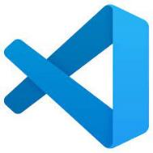
Through Prompt flow
you can use Prompt Engineering more efficiently

Slide 21
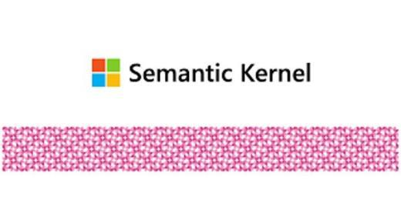
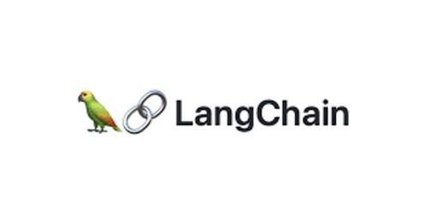
Semantic Kernel or LangChain ？​

Slide 22
For fixed business flows, it is a simple fixed Prompt
docs
Prompt
KB

Slide 23
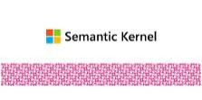

Command combination
Fornt-end
according to requirement to generation azure function and deploy to cloud
requirement
Back-end
Flask app
file
Prompt
azure
Prompt
Promptflow
Prompt
Promptflow
Promptflow

Slide 24
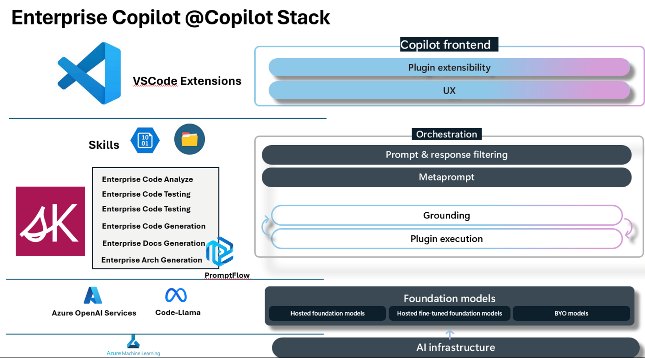

Slide 25
Demo

Slide 26

Resources
Download .NET 8 aka.ms/get-dotnet-8
Demo & Workshop https://github.com/kinfey/VSCodeEnterpriseCopilotWorkshop

Slide 27
Download .NET 8
https://aka.ms/get-dotnet-8

Slide 28
Thank you

